Slide 1
Hololens 2 Development with MRTK3
By Deyrel Diaz
Notes:
This tutorial will teach you guys how to develop eye gaze interactions within Augmented reality. Although most of the fundamental things you will learn in this presentation can be applied to other AR developments (e.g., on a Google Pixel using an Android build), this presentation is specifically geared towards helping you take advantage of the eye tracking capabilities on the HL2.

Slide 2
Overview
What is MR and MRTK
Software Stack
Setting up Unity
Configuring for the HL2
Testing the project
Code/ Demo
Notes:
The Hololens has eye tracking, speech recognition, hand tracking, spatial mapping, and so much more.

Slide 3
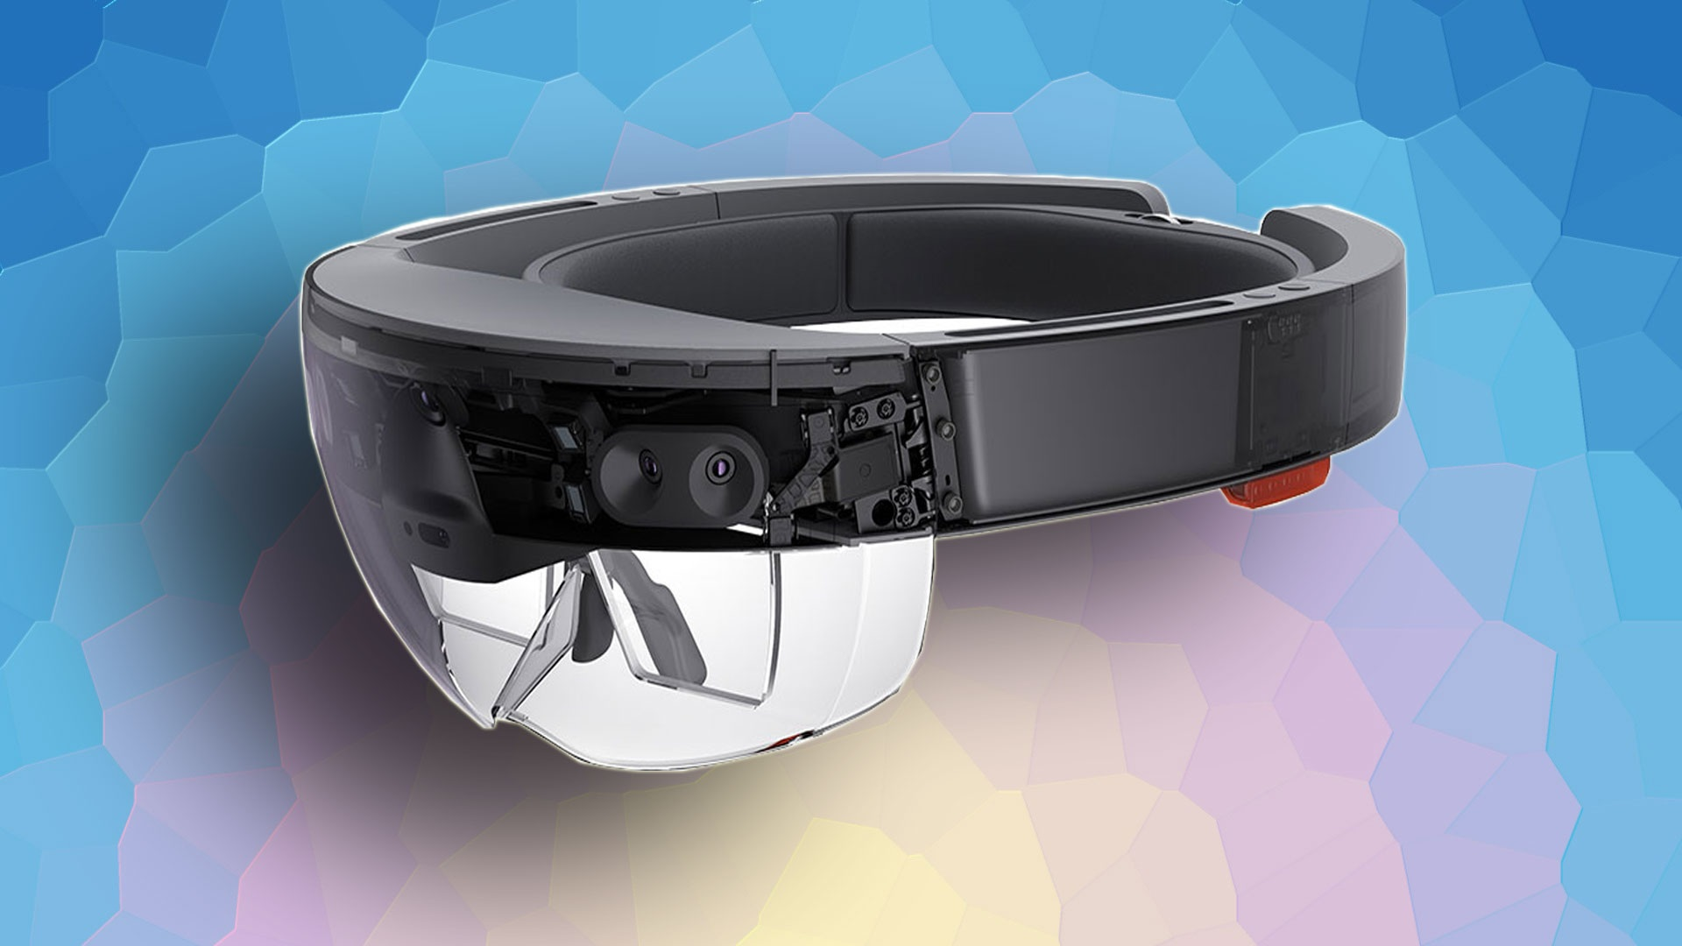
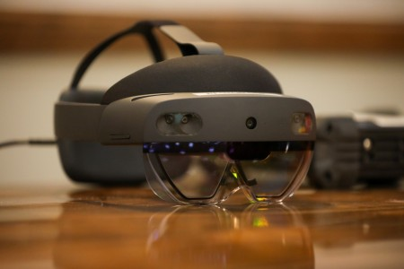

Intro
What is Augmented Reality? What is Mixed Reality?
What is the Hololens?
What is Mixed Reality Toolkit (MRTK)?
What are the main differences between MRTK2 and MTRK3?
Notes:
Augmented Reality (AR) is a technology that overlays digital information or objects into the real world, think snapchat where you could were face filters that made you look like you were throwing up a rainbow.
Mixed Reality (MR) is a technology that combines elements of both virtual reality and augmented reality, creating a hybrid environment where virtual and real objects can interact with each other in real time. In MR, the tracking is inside out, therefore the sensors looking out can map your space, know where the floor plane is, roll something off a table, etc.
The HoloLens was developed by Microsoft and released as one of the first industrial MR headsets in 2016 (v1) and 2019 (v2) with a price range between 3 and 5k. The HL is an advanced mixed reality headset that allows users to interact with digital content in a real-world environment. It uses a combination of sensors, cameras, and holographic technology to create a high-resolution, three-dimensional virtual environment that users can see and interact with in real time, using gestures, voice commands, eye tracking, speech recognition, hand tracking, spatial mapping, and so much more. MRTK is a free open-source development frameworks designed to simplify the process of creating mixed reality applications for multiple platforms, including Microsoft HoloLens, Windows Mixed Reality, and Oculus.
MRTK3 has had many improvements over MRTK2 although both are still supported and widely used. The enhancement areas were platform support, architecture, input system, interaction model, and layout system.
I originally learned MRTK2. It sucked learning how to implement interactions one way, and then completely forgetting it and having to learn a new way. MRTK3 has been re-architected from the ground up with a focus on better performance and extensibility. It features a modular architecture with a core foundation of components and services that build off of Unity XRI components. The new Input System is more flexible, supports more devices, and offers better performance. And in my opinion, it's easier to use when you get a hang of it. MRTK3 features a new Layout System that provides a more flexible and responsive layout for mixed reality applications. The system allows developers to create UI layouts that can adapt to different screen sizes and orientations.
It is recommend that you go with MRTK3. Note the elephant in the room. They have stopped production of the HL2 headset altogether. These resources are still open source, available and continuously being improved, but HL2 are limited.

Slide 4
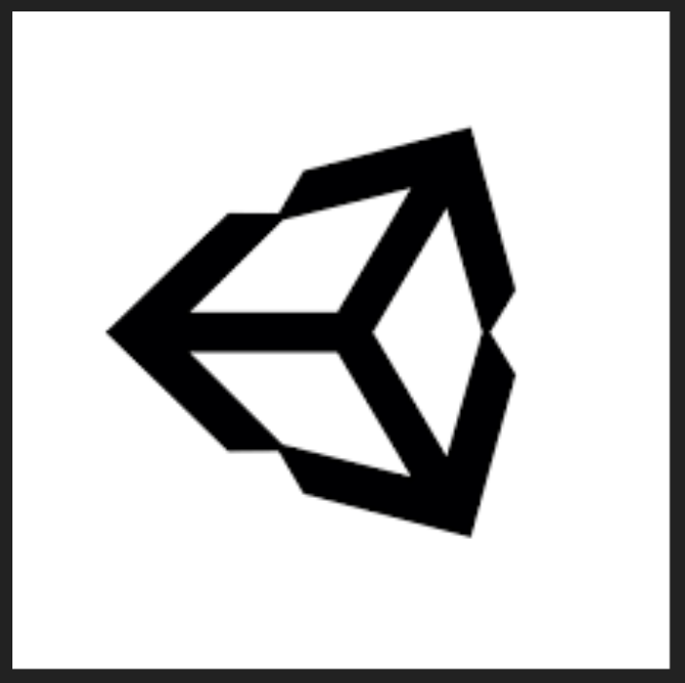
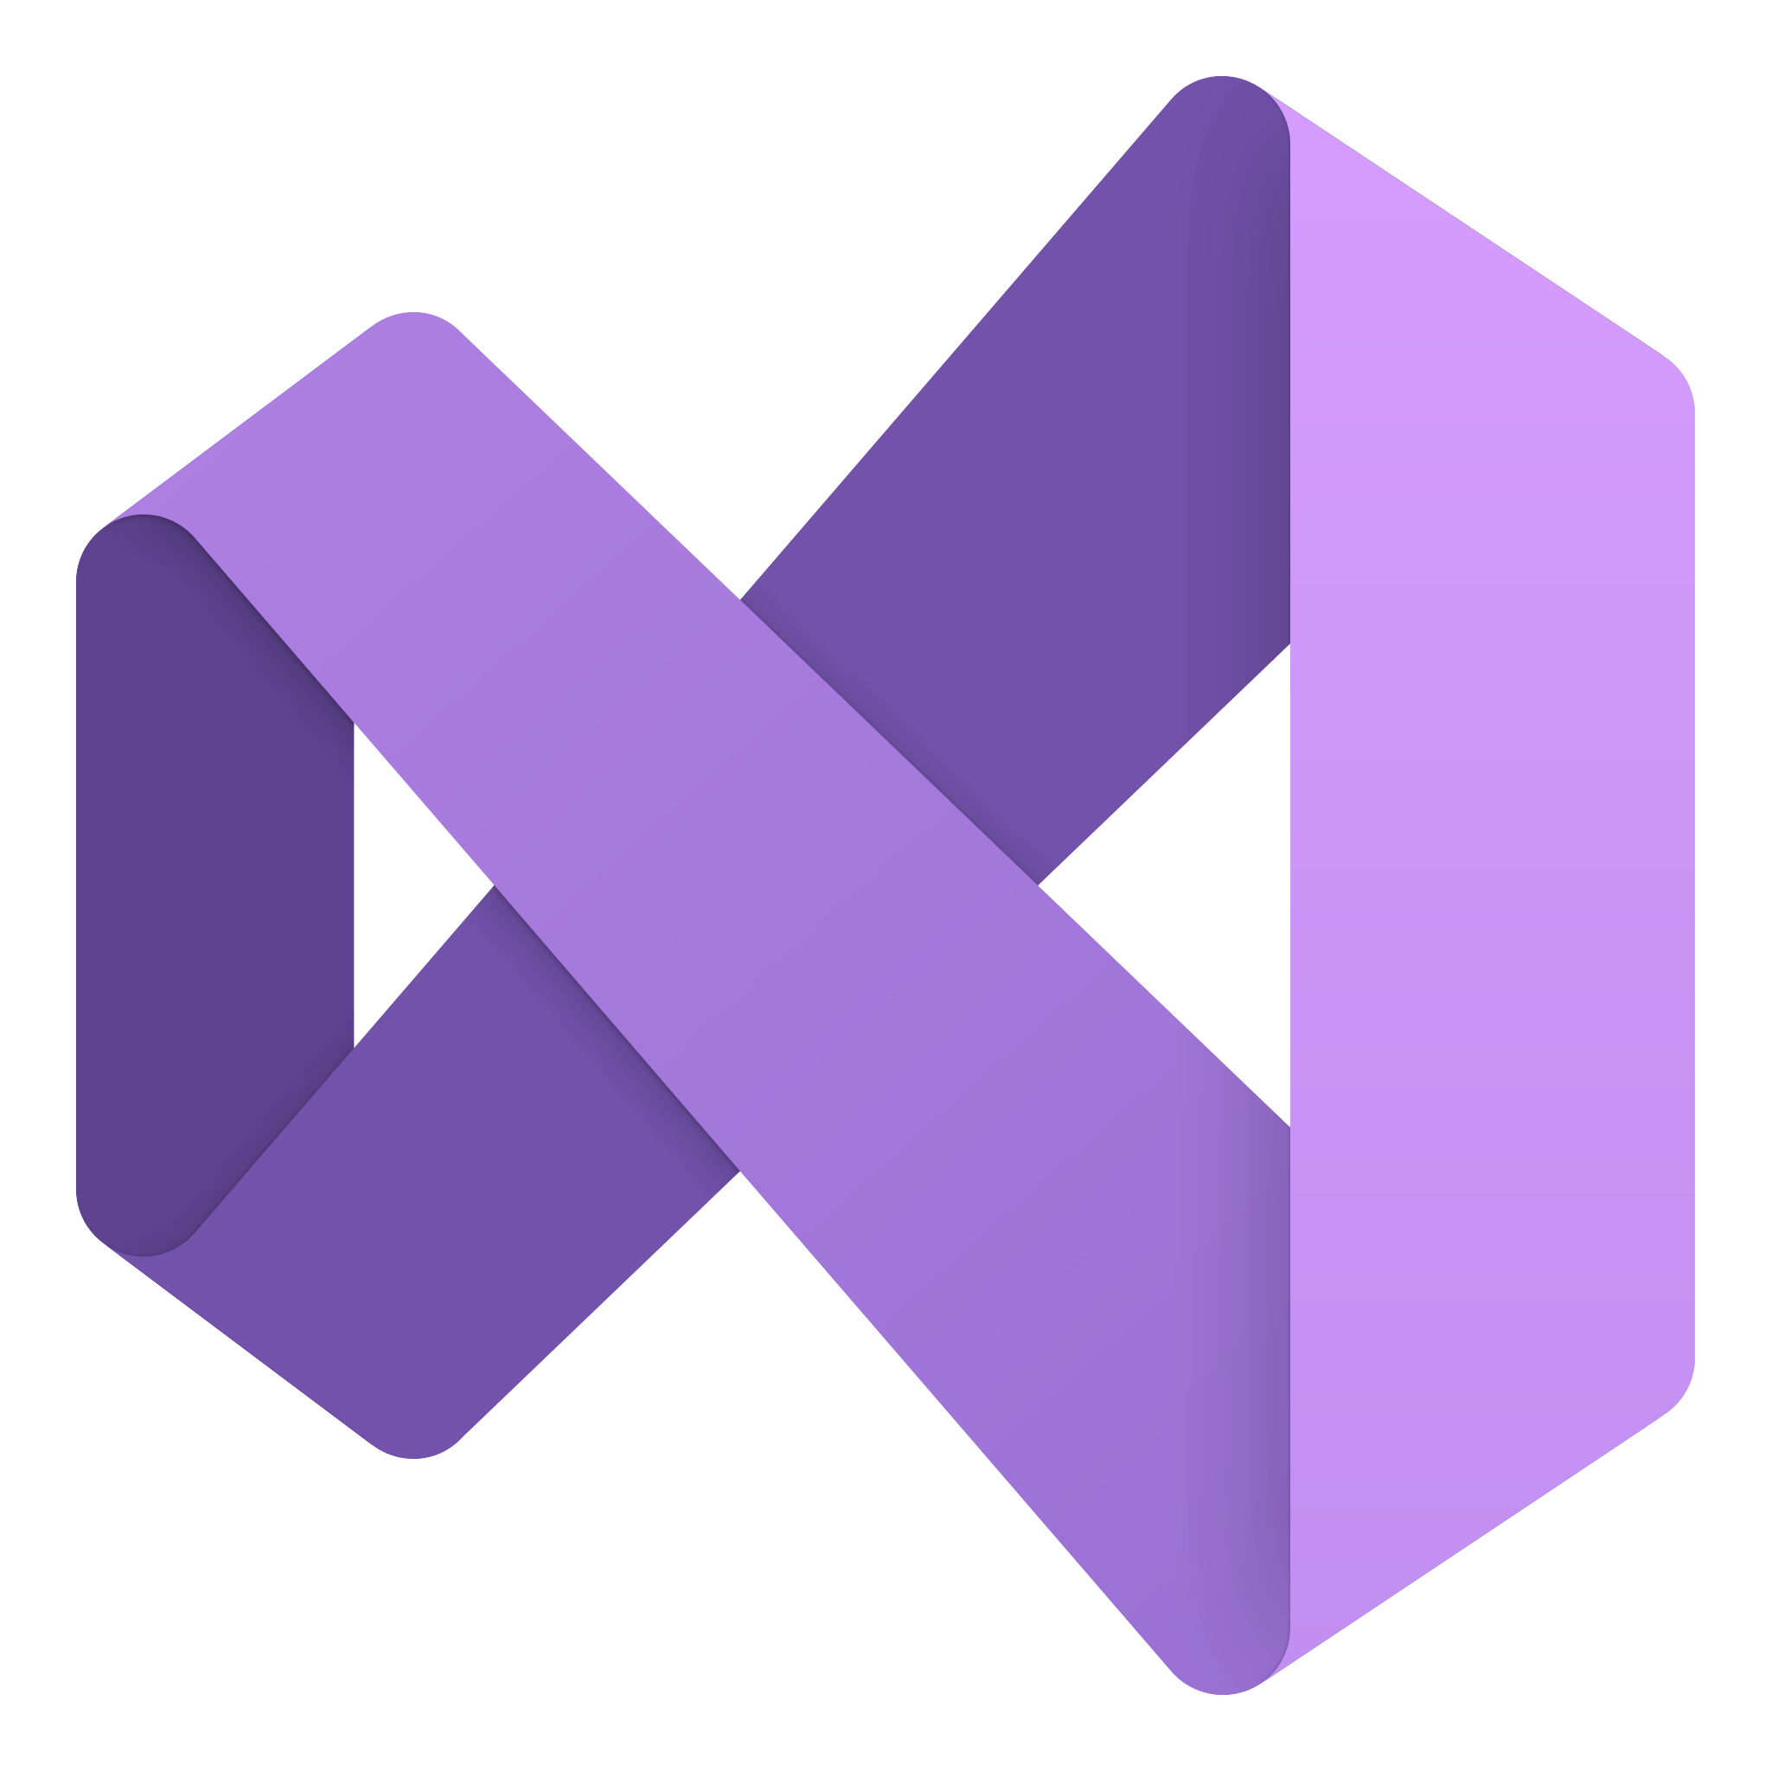
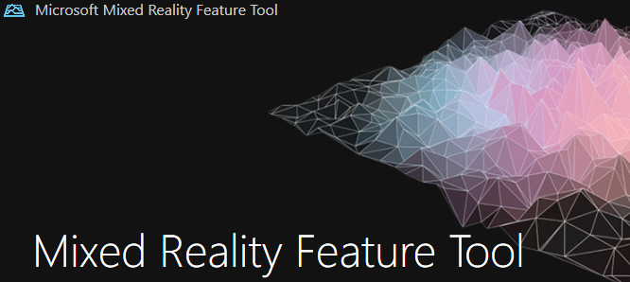
Software stack
Unity Hub with Version 2020.3.35 + (Latest LTS release recommended)
Microsoft Visual Studio 2019 + (For scripting in unity and deploying apps to HL2)
Mixed Reality Feature Tool (For importing MRTK packages into your project)

Slide 5
Part 1 -> Setting up Unity

Slide 6
Unity Hub -> Installing editor and creating a project
https://unity.com/download
Only complete step 1 where you download the Unity hub for your computer.
https://visualstudio.microsoft.com/downloads/
Make sure to install Microsoft Visual Studio with the following features:
.NET desktop development
Desktop development with C++
Universal Windows Platform (UWP) development
Game development with Unity (if planning to use Unity)
Notes:
What I am going to go through is the setup process from setting up Unity to building out on the Hololens. Make sure to follow the steps in the order in which I present as doing it another way may cause project issues down the line. The first thing we start with is making a compatible unity project with the required assembly builds.

Slide 7
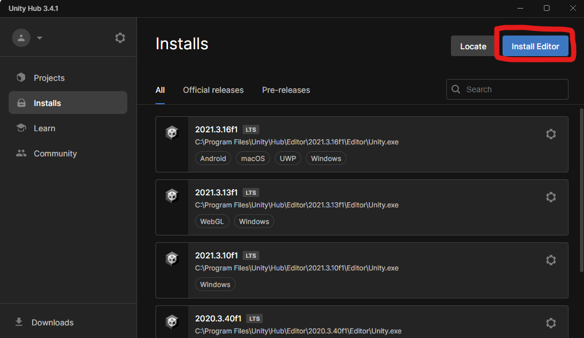
Notes:
Go to ‘Installs’ in the left menu pane and click ‘Install Editor’ to download a new unity version. Note: that your Installs window will be empty and not have any versions as shown in the image.

Slide 8
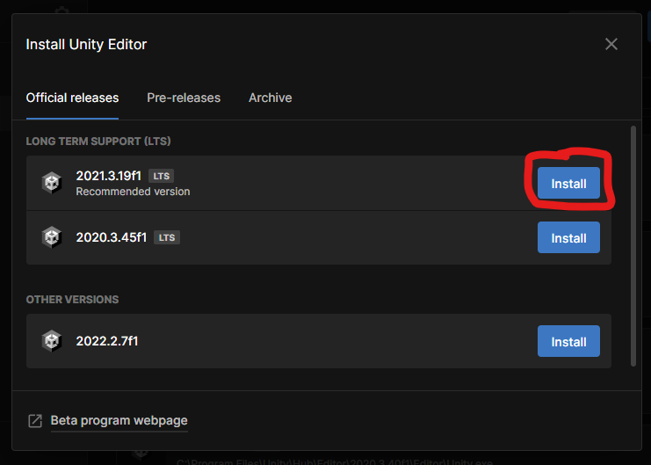
Notes:
Install the latest “Recommended Version” denoted with an LTS symbol (Long-term support). Click install.

Slide 9
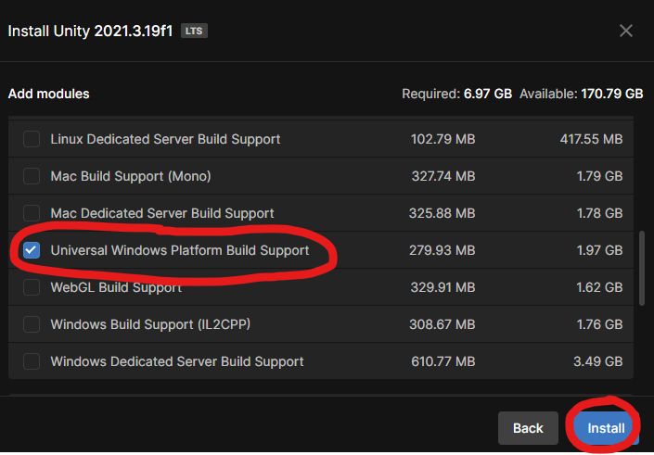
Notes:
Make sure to add the ‘Universal Windows Platform Build Support’ to your install. Click install.

Slide 10
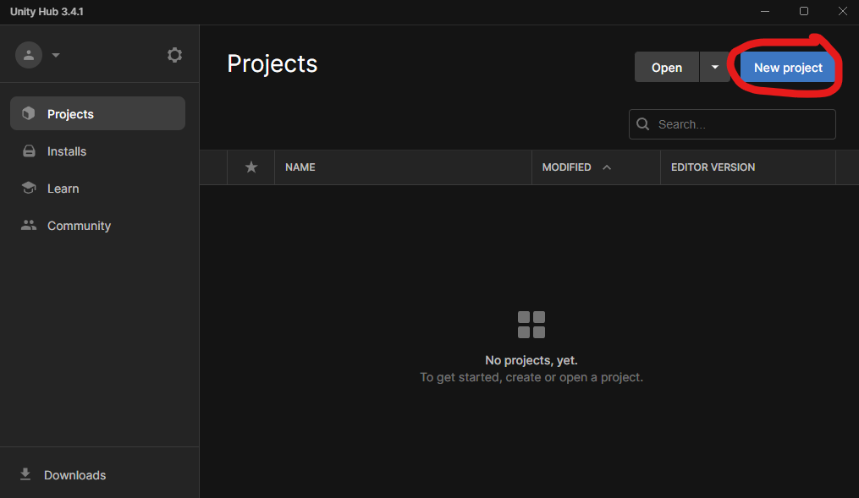
Notes:
Once completed, make a new project.

Slide 11
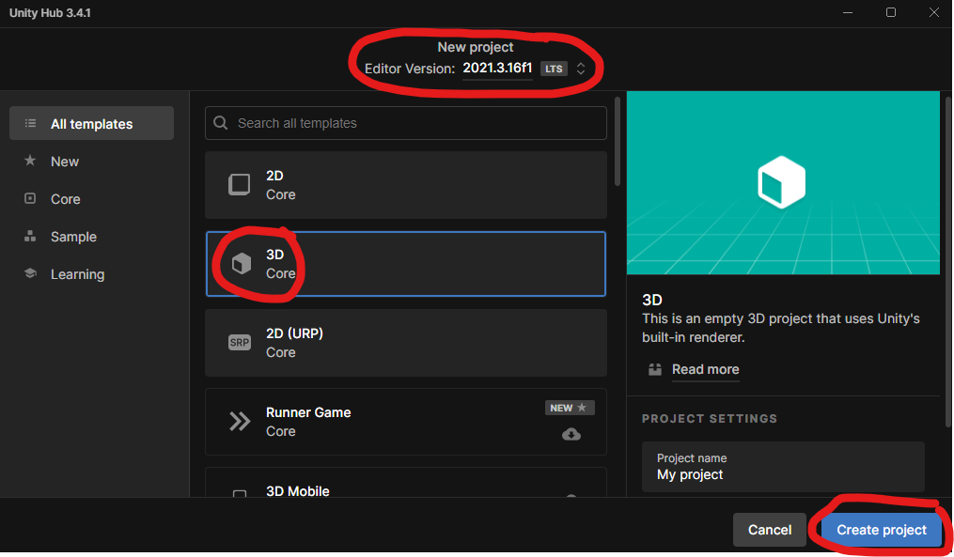
Notes:
The project should be a 3D template with the editor version you just downloaded (or another one that has windows build support). Create the project.

Slide 12
Part 2 -> Configuring for the HL2

Slide 13
Mixed Reality Feature Tool -> Get MRTK3
https://www.microsoft.com/en-us/download/details.aspx?id=102778 (MRFT download)
https://learn.microsoft.com/en-us/windows/mixed-reality/mrtk-unity/mrtk3-overview/getting-started/overview
https://learn.microsoft.com/en-us/windows/mixed-reality/develop/unity/new-openxr-project-without-mrtk
Notes:
With the MRFT you need to have already created a Unity Project and need to download the executable from Micrsosoft.com
As I mentioned before, you need to follow things in order as the MRFT requires you to have already created a Unity Project in order for it to correctly adjust the assembly/ .dll file.

Slide 14
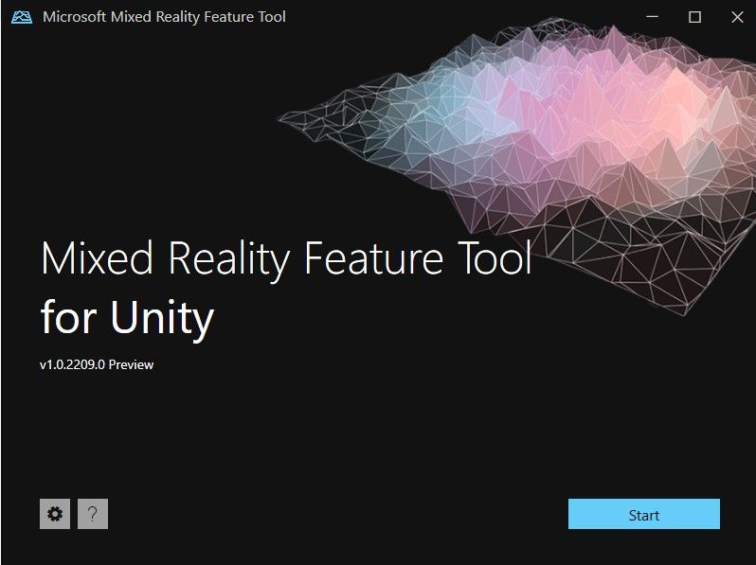
Notes:
With the MRFT you need to have already created a Unity Project. Here you select the path where that folder is located so you can add in all the necessary files and packages.

Slide 15
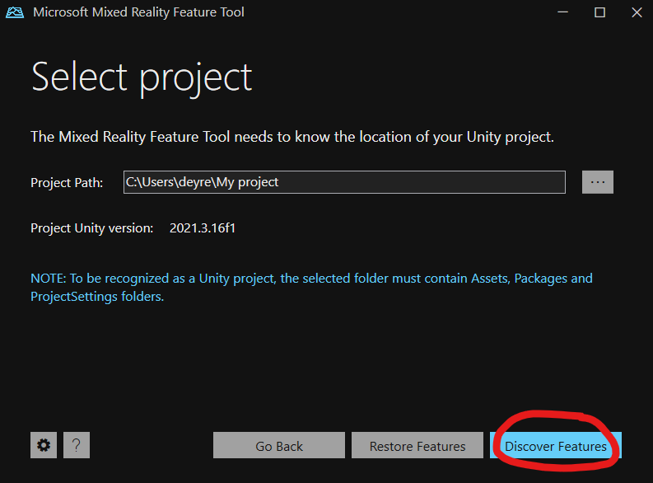
Notes:
With the MRFT you need to have already created a Unity Project. Here you select the path where that folder is located so you can add in all the necessary files and packages.

Slide 16
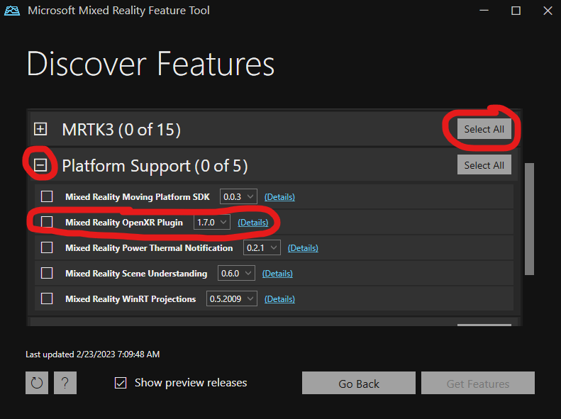
Notes:
For your purpose, just go ahead and select all for MRTK3 and expand the “Platform Support” Menu and select the OpenXR Plugin. When you get a better understanding of MRTK3, you can specifically import only what you need to keep your project lean.

Slide 17
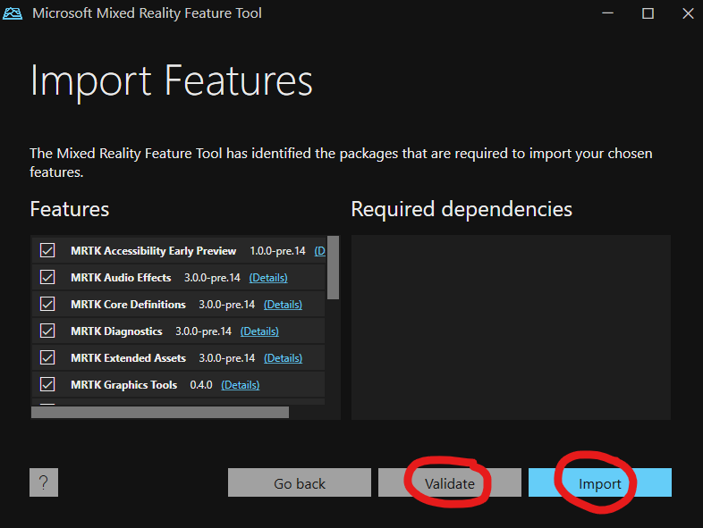
Notes:
Click Validate then import. Note: When you click validate, you should get a pop up box that says there were no issues detected.

Slide 18
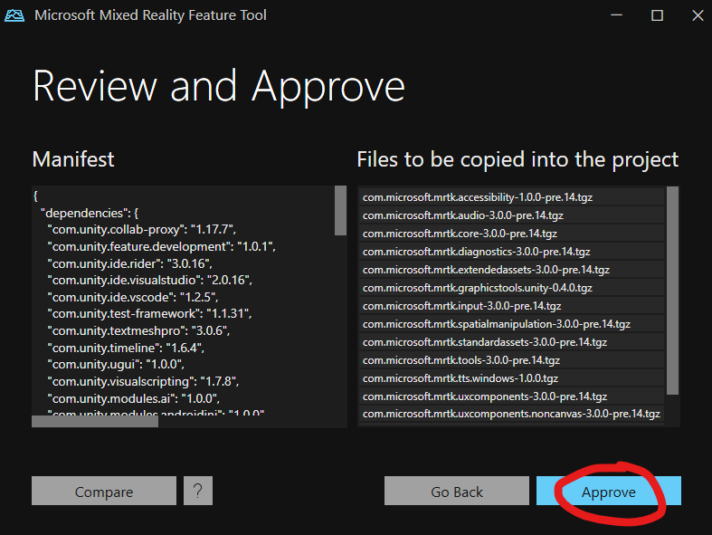
Notes:
When you approve, you will get a dialog that your project has been updated.
At this point, you need to go back into the unity project and configure your build.

Slide 19
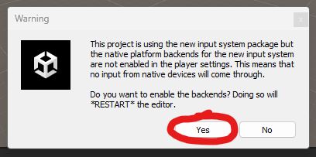
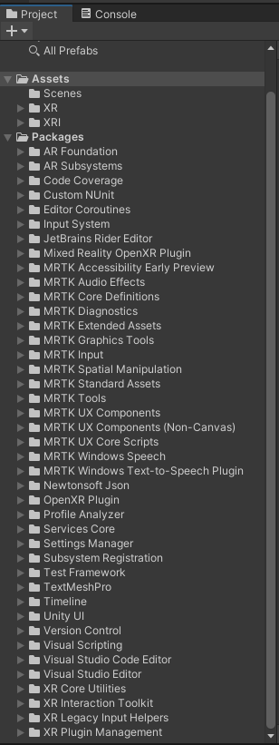
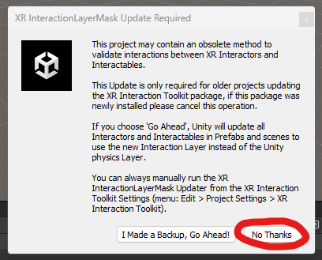
Notes:
When you go back into your Unity Project, you will see some things download and then 2 dialog boxes will pop up. The first one is to automatically update your player settings and then the next one is for older project, which you can ignore.
When all is said and done, you will see all of the imported folders in your project pane.

Slide 20
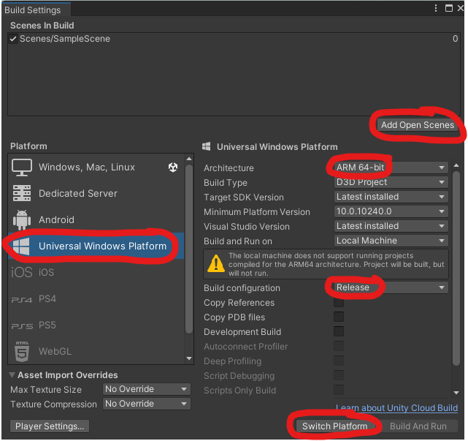
Notes:
In File > Build Settings Menu in your unity project, change the required settings to port for the Hololens. Everything else should already be populated as shown.

Slide 21
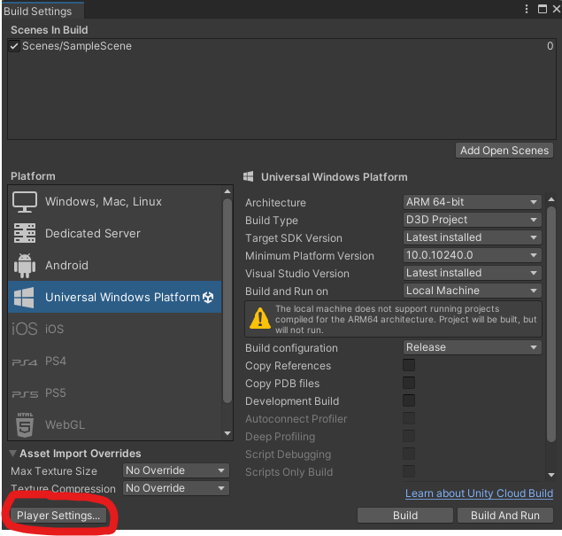
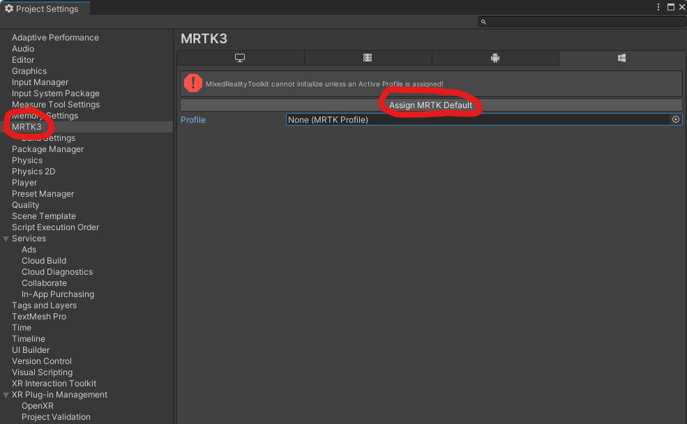
Notes:
Once done, click on the player settings to adjust some MRTK settings. Assign a Default profile to your project. MRTK Profiles support specific scenarios for multiple devices (Including the HL1 and 2, Open VR, and WMR), which are handled by data providers.

Slide 22
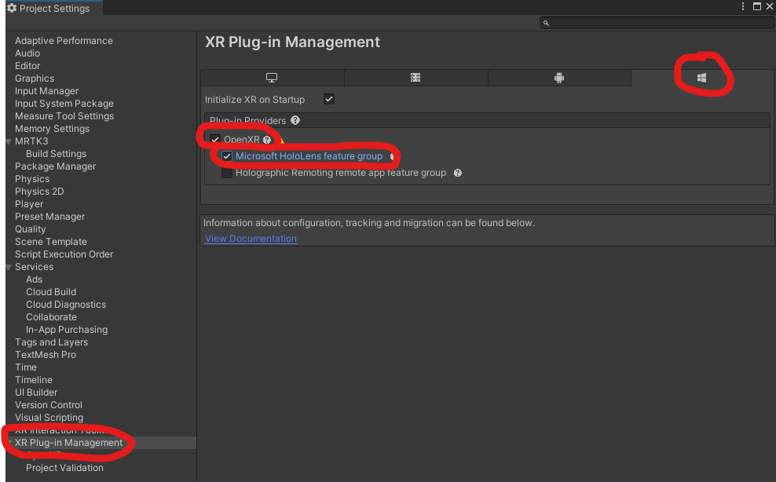
Notes:
In the XR plugin management setting, make sure you have the Hololens supported for Open XR.

Slide 23
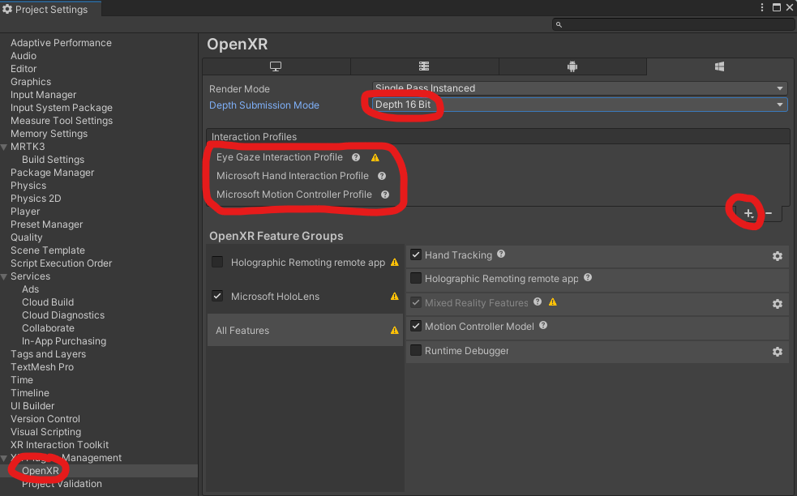
Notes:
In the OpenXR setting make sure the render mode is single pass instanced and has a Depth 16 Bit. Make sure that the following interaction profiles shown in the image are added. Note: you only need the eye gaze interaction profile for eye tracking, but having the other one will help you explore other features too.

Slide 24
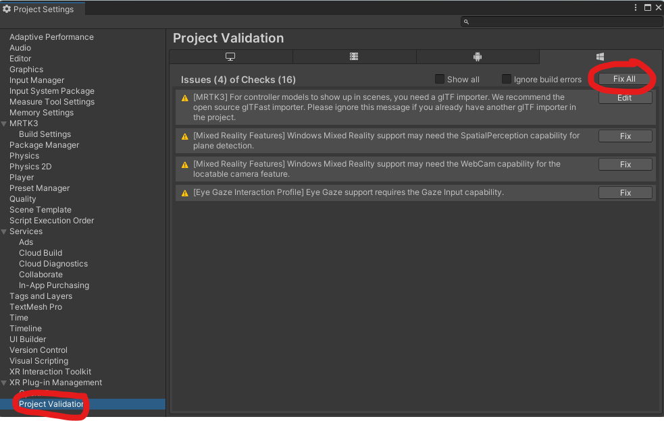
Notes:
Fix all project validation errors.

Slide 25
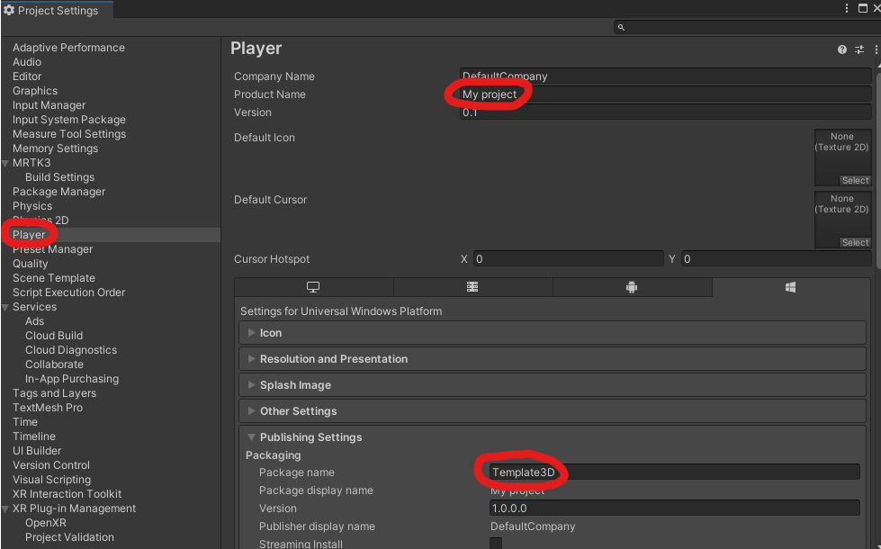
Notes:
If you don’t do this step, you may get conflicts when trying to run your app as another user on your Hololens device.
Note: Edit this, but this only effects you when you plan to run it on the physical HL2 device.

Slide 26
Scene Setup
The most important gameobjects to include.
Notes:
For using the input simulator

Slide 27
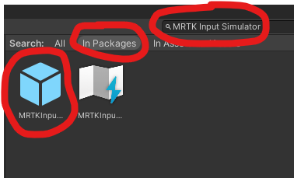
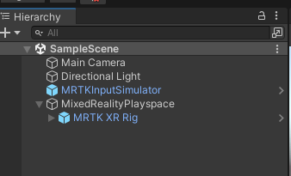
Notes:
Right click in the hierarchy and “Create Empty”. This creates an empty game object to which you want to name “MixedRealityPlayspace” Notice the Capitalization. For some reason, some MRTK things are dependent on the reference of this gameobject to function. Make sure to put anything that will be interactable, nested within the playspace gameobject. After that, look in your packages for an XR Rig. Drag and drop the one called MRTK XR Rig within your MRPs gameobject.
There is an optional MRTK Input Simulator that you can use, even if you don’t have an XR Device. This let’s you emulate eye tracking, speech, and hand tracking using your keyboard, camera and microphone.
Using the simulator is great for rapid prototyping and seeing how certain things work from a functionality perspective. This one is also great for seeing how or if your code works. The benefit of this is that you don’t even need to own a Headset to build and test things. The downside to this is that it is not very close to what the user sees in the Headset and you can’t accomplish every interaction as with other building methods. The interaction method also uses your keyboard and is on the screen, so parallax and other perspective cues are lost.

Slide 28
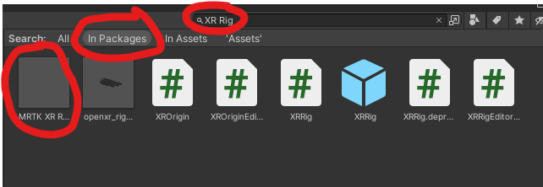
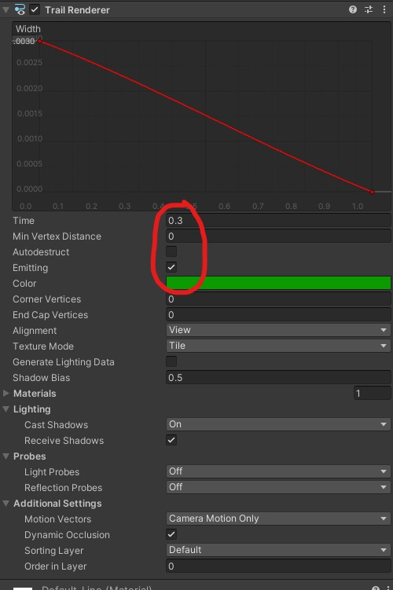
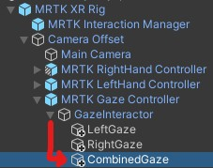
Notes:
The MRTK XR Rig is super important for eye tracking as it has the Fuzzy Gaze Interactor which lets you adjust the raycast properties (like raycast distance, raycast type (projectile, straight line, bezier curve), gaze distance (interaction at specified distances)). This component is what lets you interact with UI and 3D objects.
Although you can just add in just the Gaze interactor, you are better off adding the entire MRTK XR Rig for future development/ interoperability.

Slide 29
Part 3 -> Testing the project

Slide 30
Ways to Test
Least
MRTK Input Simulator
Holographic Remoting Player
Universal Windows Platform (Build)
Level of Fidelity
Greatest
Notes:
There are so many ways to build out onto the Hololens. I will go through 3 different ways with different levels of fidelity. I will also discuss the pros and cons of each. You don’t have to implement all 3, but it doesn't hurt. I personally use all 3 and it helps increase my work productivity. In order to actually test your project though, you atleast need to use one.

Slide 31
MRTK Input Simulator
For desktop experience/ prototyping.
Notes:
For using the input simulator

Slide 32
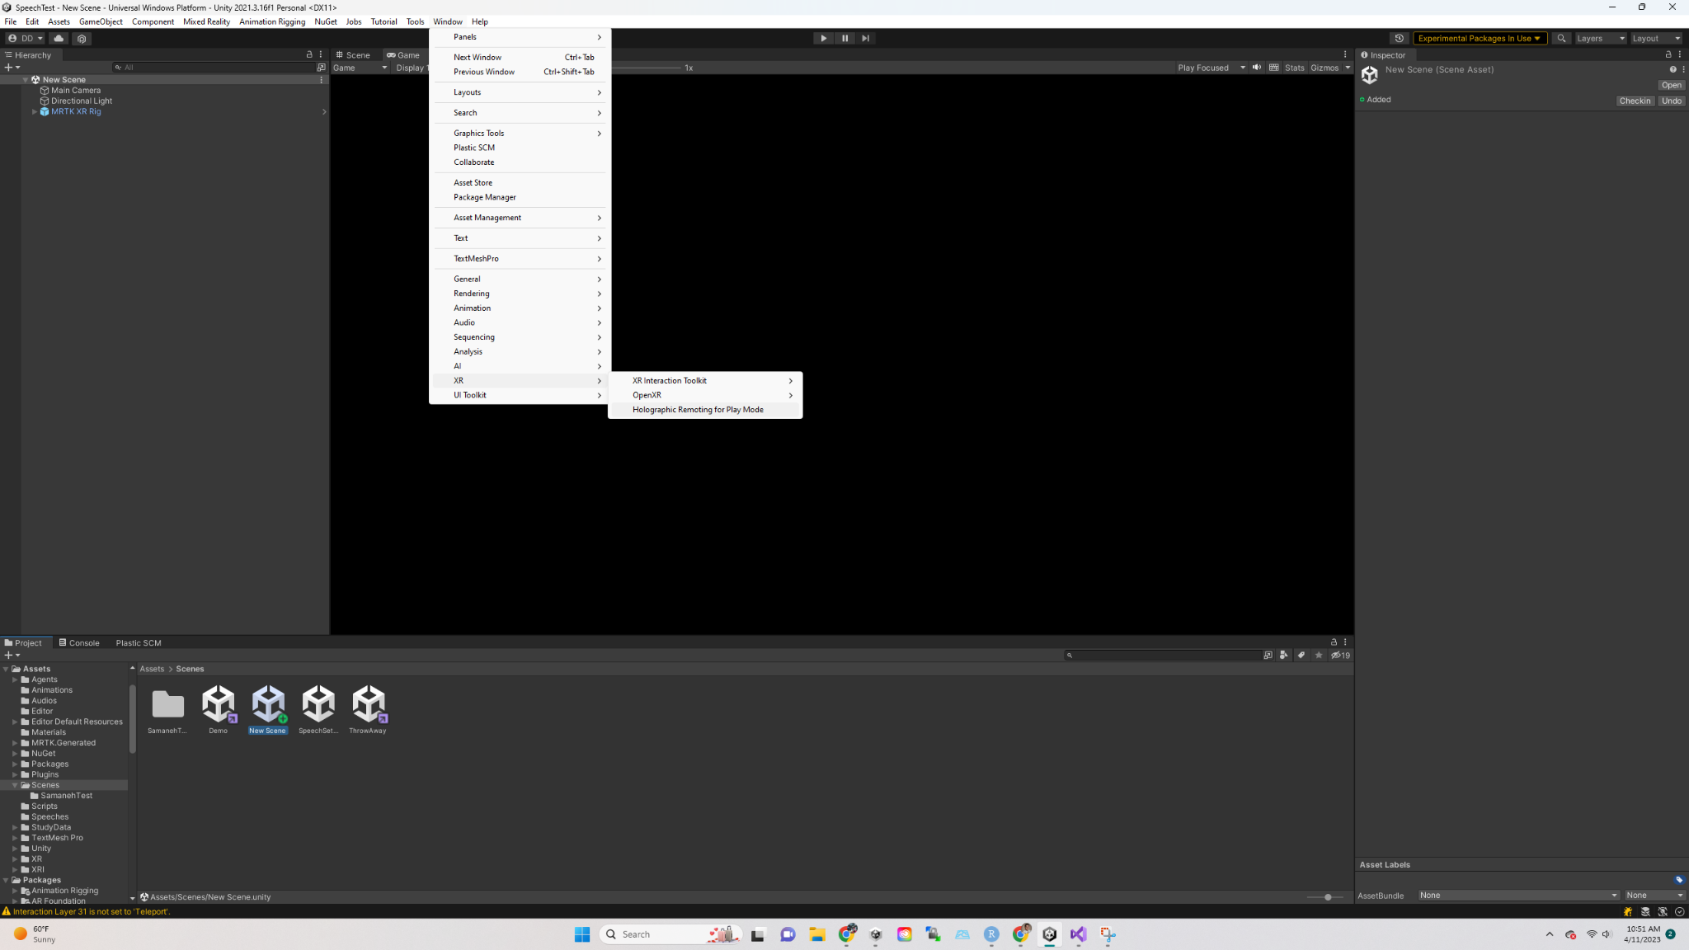
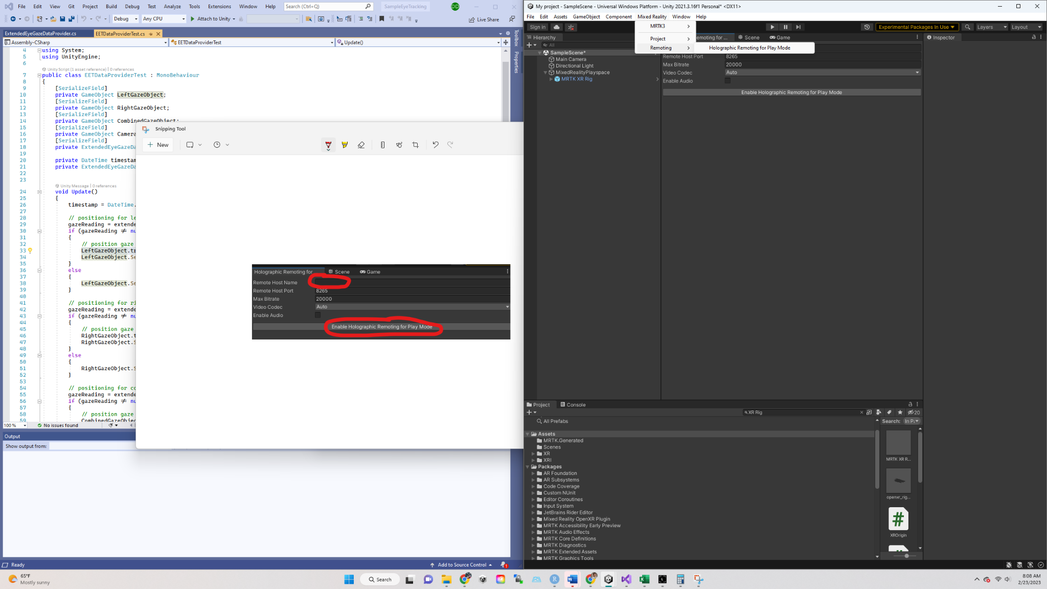
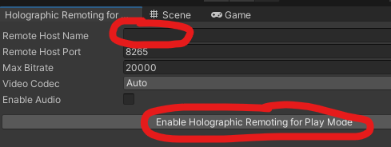
Ask in the HL2: “What is My IP?”
Notes:
Now, go back into Unity and go to the to Mixed Reality toolbar. Go to Mixed Reality > Remoting > Holographic…
Enter the IP Address from the app in the unity Remote Host Name section and enable the playmode.
When you hit the play button in the Unity Scene, it will remotely connect to your HL2 and let you see everything in the Hololens AND Unity. Note: Both devices need to be on the same wifi network for this to work.
This build type is great for rapid prototyping, seeing how certain things directly work on the Hololens, and how latency is effected with the addition of new objects. This one is great for seeing how the actual user will experience the environment and how interactions work with the real world. It is also good to allow you to not only do things in the headset, but also someone else to see what you are doing on a different computer screen through Unity. The downside to this is that you can only run it concurrently with unity so you need to have unity open while working on this. Because of the data transfer through wifi, the experience is a little slower than it would be in a full on build (but not that significant in my opinion). Despite you being able to port out things onto the device, there are still certain things that you cannot do without the build (e.g., extended eye tracking which allows for more granular data capture).

Slide 33
Holographic Remoting Player
For physical HoloLens 2 device experience.
Can also be seen on the desktop while the user plays.

Slide 34
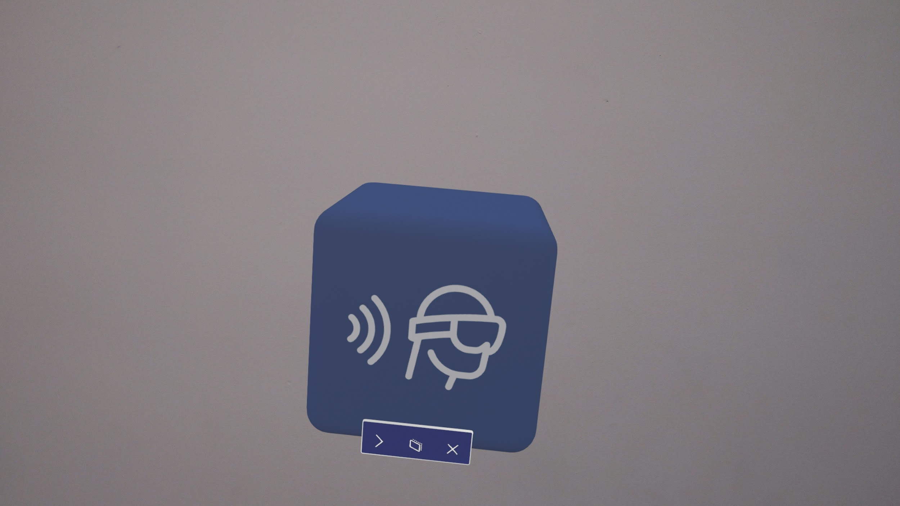
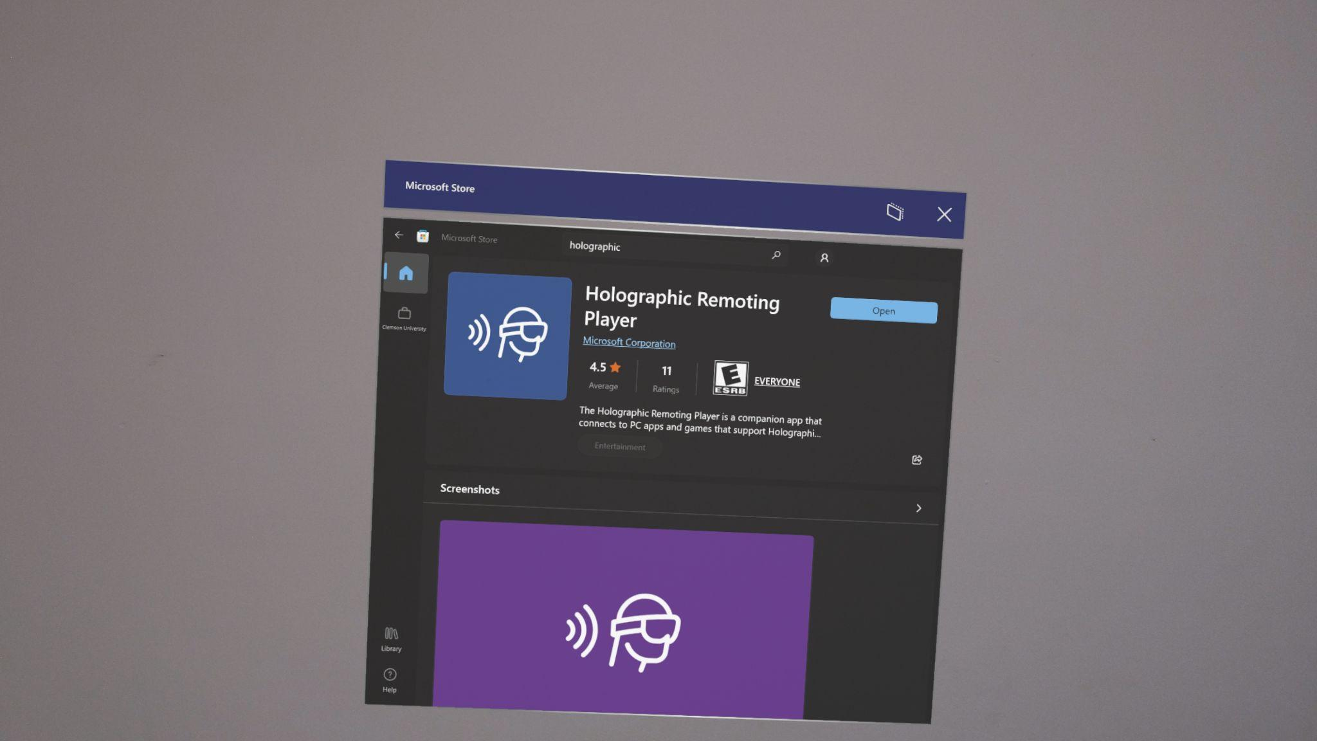
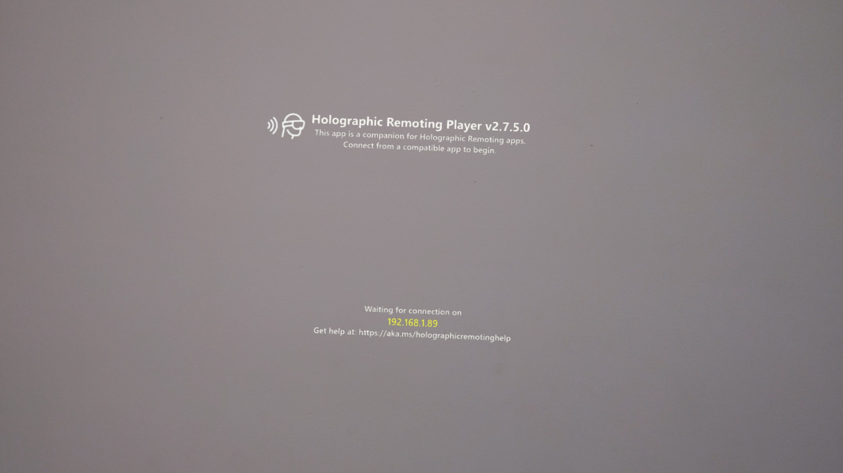
Notes:
The one with highest Fidelity is the holographic remoting player.
In order to get this feature, you need to Download the Holographic remoting app from the Microsoft Play store directly from the Hololens for this to work.
Once downloaded, open the App in the HL2 and you will find the IP address.

Slide 35
Universal Windows Platform (Standalone Build)
Only for the physical HoloLens 2 device.

Slide 36
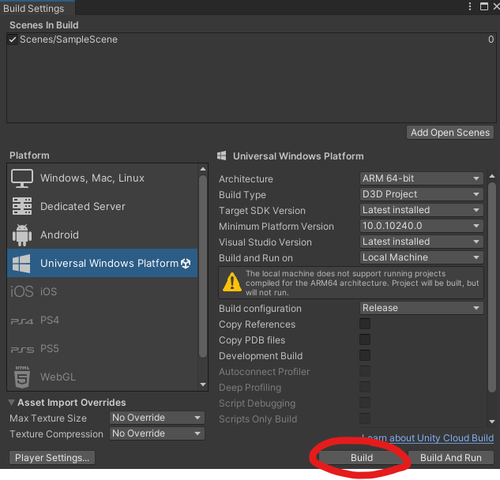
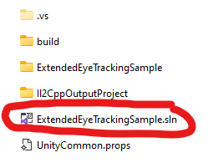
Notes:
To run as a standalone app on the HL2, you have to build the project. When you Build the Project you will create/ select a project folder. Once built (may take a couple of minutes) Select the .sln file to open up the project on the HL2 and Visual Studio.
Note that you need to have the Windows Build feature option selected for your visual studios build.

Slide 37
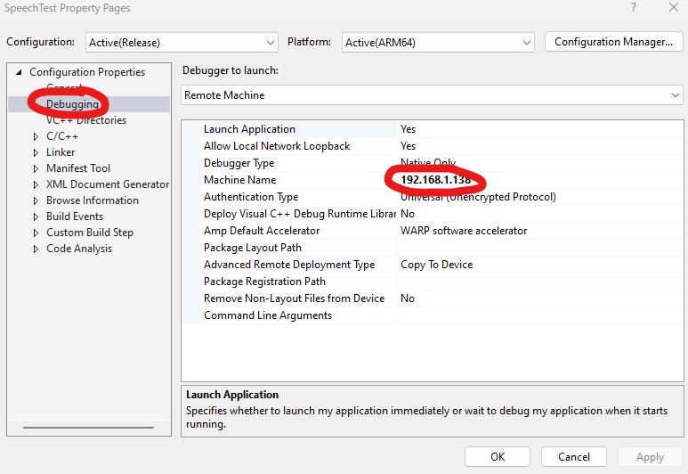
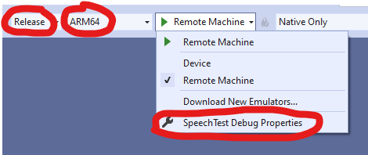
Notes:
In order to play the scene from VS,

Slide 38
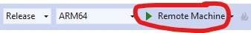
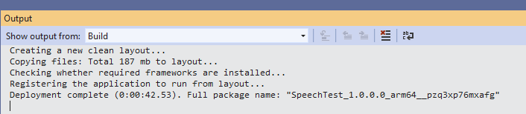
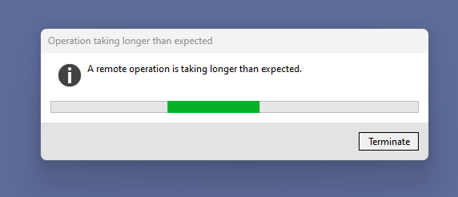
Notes:
When you see this dialog box, don’t do anything, that means that the project is uploading perfectly. Sometimes, this take a few minutes to build, so be patient.
This build type is great for having a build that you can test many times and take anywhere, despite not having unity open or being on the same network of the build. It will give you the most accurate version of the built experience and latency. You can use this build and transfer it to other devices if needed. The bad part about this is that you have to wait for this to be built, which sometimes can take up to 10 minutes. This is not great for small design adjustments like when changing thing slike layout or color and seeing how it looks.

Slide 39
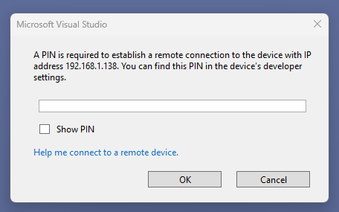
Notes:
When you hit the play button, the project will start building. As long as it catches the IP address correctly, it will ask you for a pin to pair the device. You only need to do this the first time you pair the devices together.

Slide 40
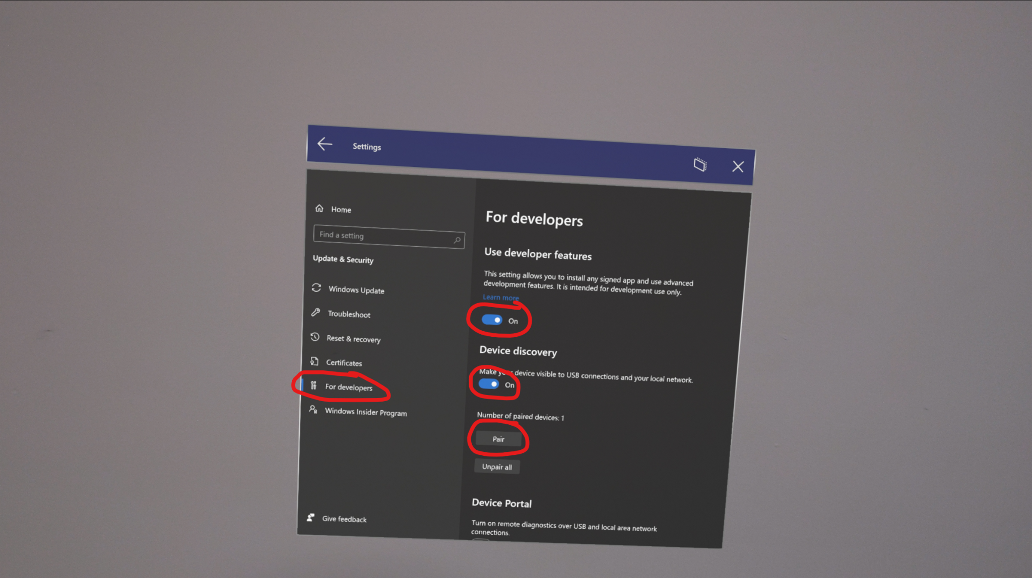
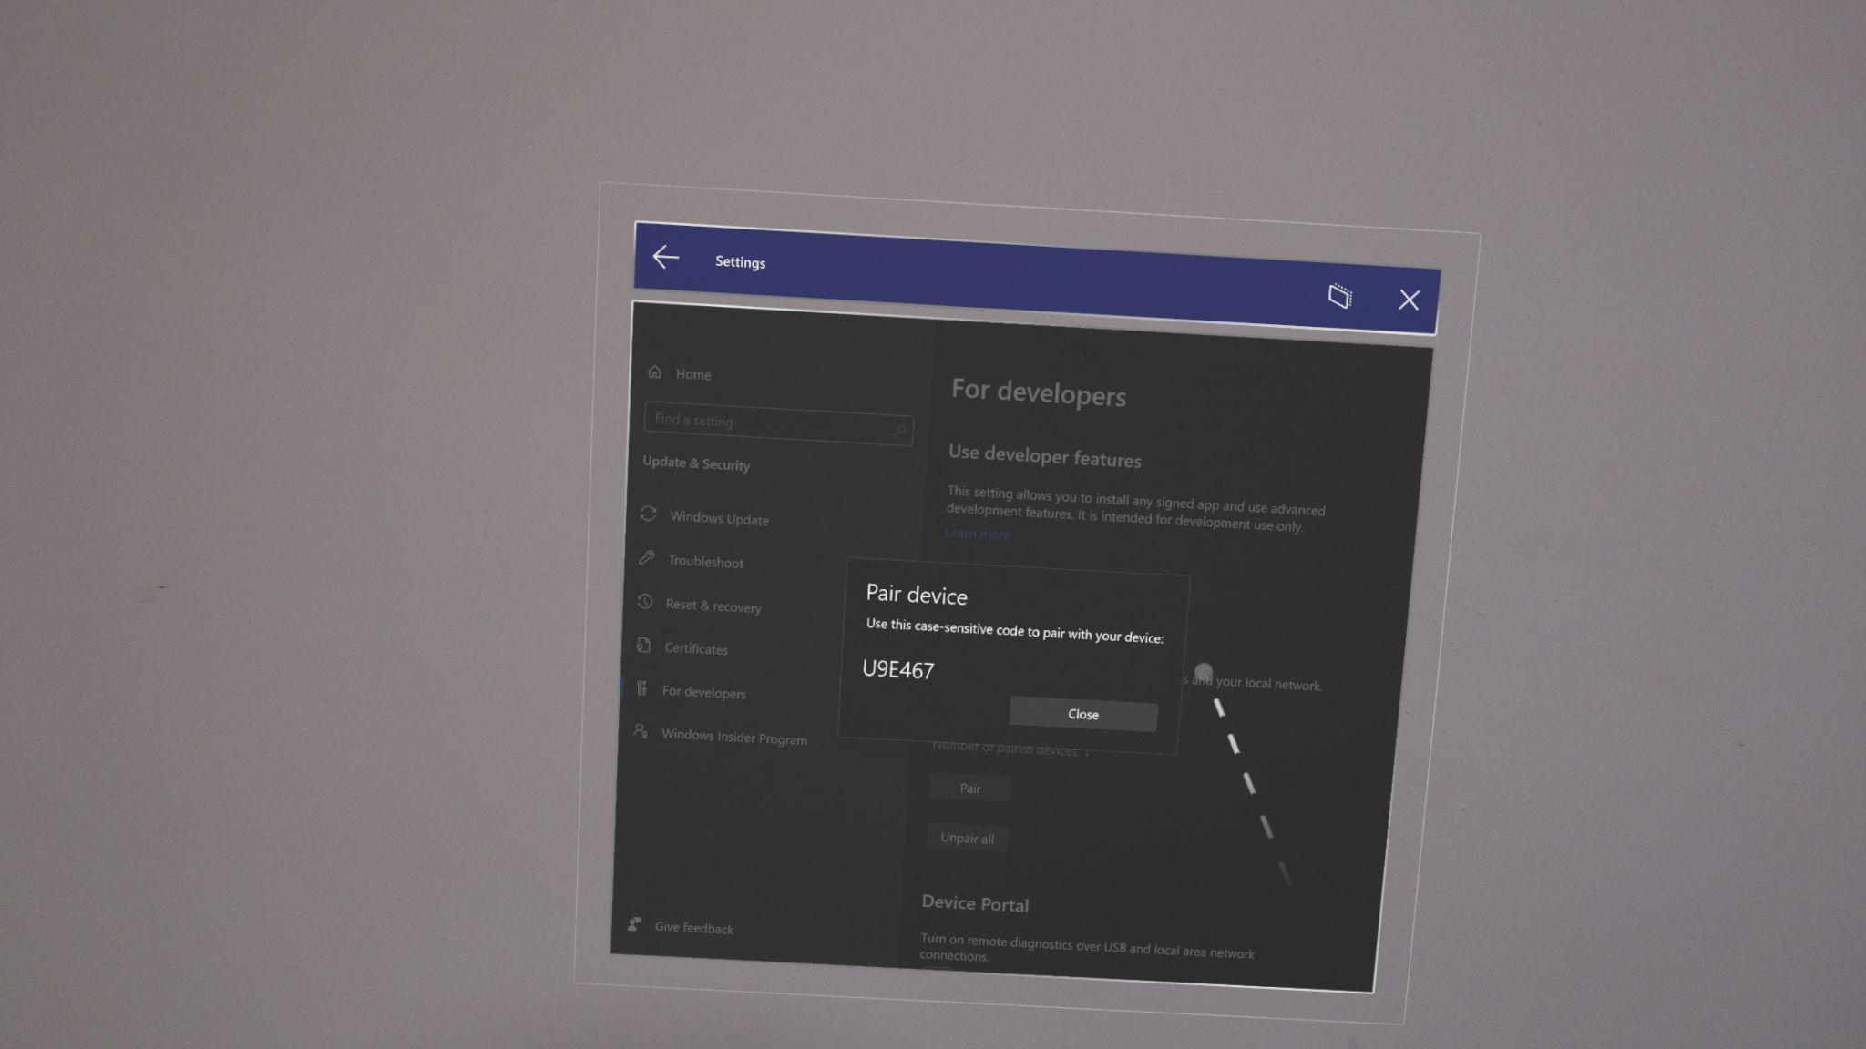
Notes:
When pairing the device, you have to make sure that HL2 developer settings are enabled.

Slide 41
Customizing your app
You can change the Project Name.
You can change the Project Image.

Slide 42
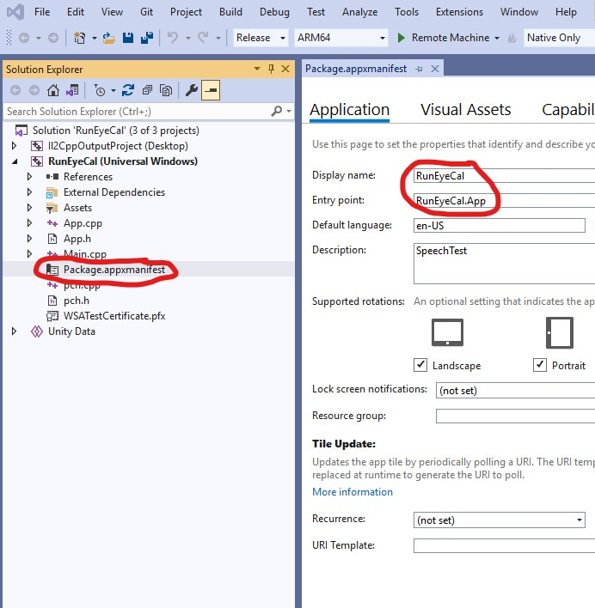
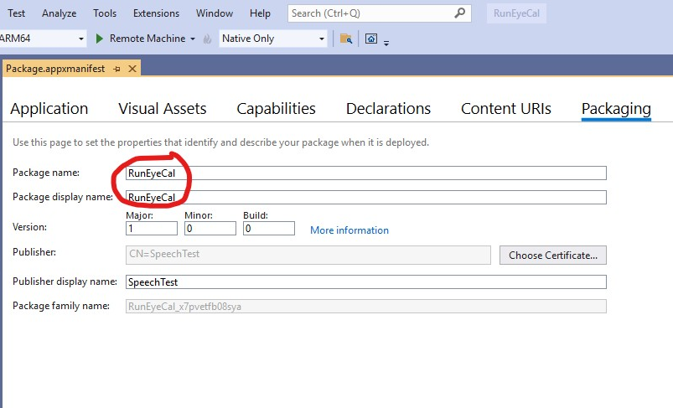
If solution explorer not present go to: “View > Solution Explorer”
Notes:
To easily alter the application name or appearance, you need to edit the Package Manifest that comes with the solution build. From there you can alter the name of the app and package. With the respective tabs. I like to have them named something different or else, the apps will override each other.

Slide 43
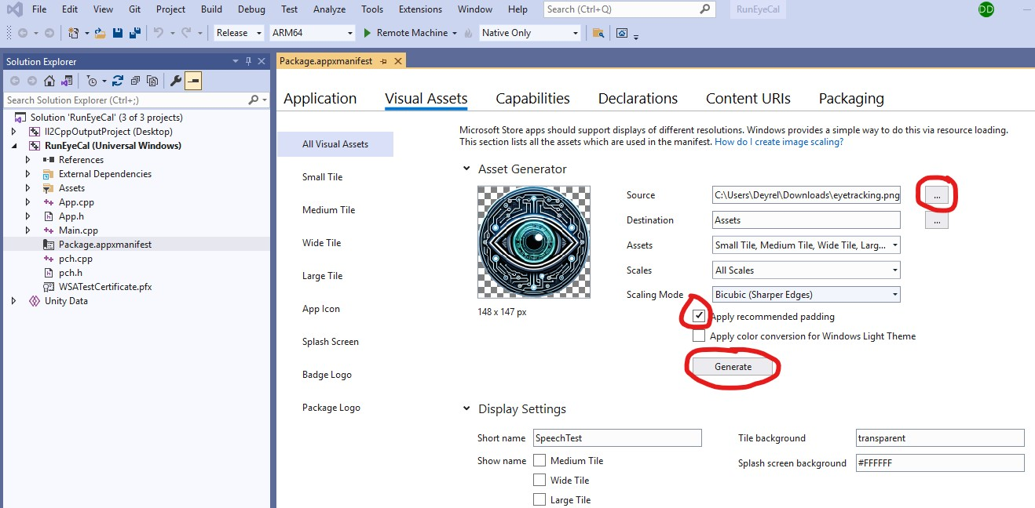
Notes:
You can change the icon on the app by selecting a generated image from your computer, making sure it applies padding, and hitting generate.

Slide 44

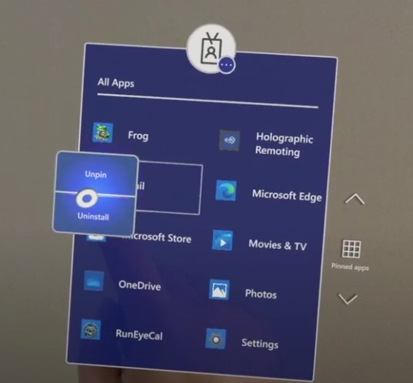



Notes:
Here is a video that shows the customized app within the Hololens. As you can see, the home screen is accessed by looking and pressing the windows icon on your wrist. Additionally, if you have an application that interacts with your environment, you can pinch your fingers together to allow the device to map the topology of your space.

Slide 45
Getting Images/ Data
You can store gaze or interaction data to folders on the HL2.

Slide 46


Notes:
In order to store or work with data within the HL2, you must use directives. This can be a little more complicated, but here is a quick code snippet to show you how to atleast add a folder.

Slide 47


Notes:
You need to make sure the HL is on and logged in, in order to see it appear as a removable storage device on your computer. Usually you can tell it’s connected/ on when the charge lights are lit up. I typically story all the data files within a folder within the 3D objects folder.

Slide 48
Part 3 -> Code/ Demo

Slide 49
Demo
Let’s go into Unity.
Let’s see how to get eye tracking to work.

Slide 50
Other Helpful Resources

Slide 51
Viable Speech Commands on the HL2
https://learn.microsoft.com/en-us/hololens/hololens-cortana (speech commands)
Notes:
This link right here takes you to a list of things you can say while wearing the Hololens.

Slide 52
MRTK3 GUI (Hand & Eye Interactions)
Dynamic
Easy to program interactions
https://learn.microsoft.com/en-us/windows/mixed-reality/mrtk-unity/mrtk3-uxcomponents/packages/uxcomponents/overview
https://learn.microsoft.com/en-us/windows/mixed-reality/mrtk-unity/mrtk3-uxcomponents/packages/uxcomponents/button

Slide 53
Setting up the scene for Eye tracking
https://youtu.be/gWFOw_yb9vY (MRTK Eye Tracking)
Notes:
This link explains to you in a different way about gaze, pinch, and the MRTK UI on the HL2

Slide 54
Extended Eye Tracking
Unfortunately Extended Eye Tracking DOES NOT work with Holographic Remoting Player
Install the latest OS Version on the Hololens 2 (Settings > Update and Security)
https://learn.microsoft.com/en-us/windows/mixed-reality/develop/unity/extended-eye-tracking-unity#project-setup
https://github.com/microsoft/MixedReality-EyeTracking-Sample
Notes:
Unfortunately Extended Eye Tracking DOES NOT work with Holographic Remoting Player, so you HAVE TO build it out to see ti work/ debug.
Having the latest OS allows you to use newer features added after the fact like left and right eye gaze.
EET allows you to record eye gaze data at 60 fps or 90 fps.

